Slide 1
Formatted Mailer
Name : Mohit Suthar
Roll no : 78
Enroll : 22002170410017
Batch : B3 Branch : AIML

Slide 2
Intro
The purpose of this is to simplify the process of those community having many subscribers by Email
By empowering the admin to select predefine format as per the need

Slide 3
Merits
Ready formats
Easy to use
Sends to multiple
The Inbuild predefine formats makes the work simpler
Have good flow of menus, makes easy in navigation
Sends formatted mail to multiple mails in single send

Slide 4
Future scope
GUI
More formats
Gui can be implemented by using tkinter ,pygame, etc
More predefine formats can be added for wider use
Data Base connection
More predefine formats can be added for wider use

Slide 5
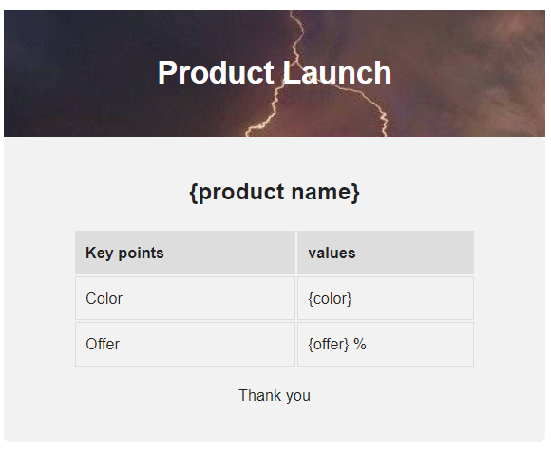
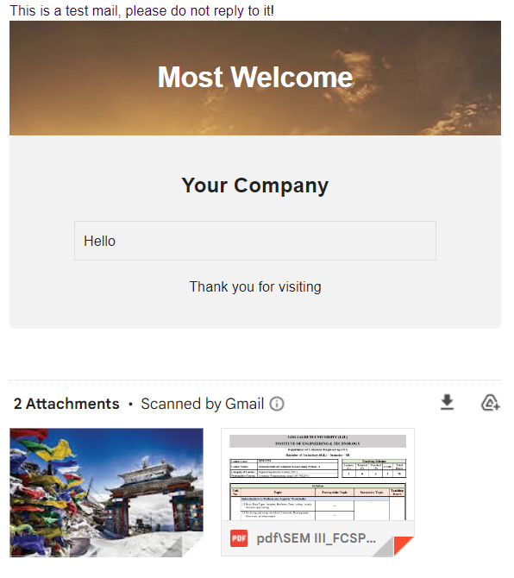
Thanks!

